Slide 1
Logistic Regression – Complete Problems
Outliers and Influential Cases
Split-sample Validation
Sample Problems

Slide 2
Outliers and Influential Cases
Logistic regression models the relationship between a set of independent variables and the probability that a case is a member of one of the categories of the dependent variable (In SPSS, the modeled category is the one with the higher numeric code.) If the probability is greater than 0.5, the case is classified in the modeled category. If the probability is less than 0.50, the case is classified in the other category.
The actual probability of the modeled event for any case is either 1.0 or 0.0, i.e. a case is in the modeled category or it is not.
The residual is the difference between the actual probability and the predicted probability for a case. If the predicted probability for a case that actually belonged to the modeled category was 0.80, the residual would be 1.00 – 0.80 = 0.20.

Slide 3
Standardized residuals
The residual can be standardized by dividing it by an estimate of its standard deviation. Since the dependent variable is dichotomous or binary, the standard deviation for proportions is used.
If a case has a standardized residual larger than 3.0 or smaller than -3.0, it is considered an outlier, and a candidate for exclusion from the analysis.

Slide 4
Influential cases
Cook's distance is computed by SPSS as a measure of the influence which a case has on the solution. This is the same statistic use used as measure of influence in multiple regression.
However, the criteria for determining that a case is an influential case in logistic regression differs from the criteria in multiple regression.
In logistic regression, a case is identified as influential if its Cook's distance is greater than 1.0. This is based on a statement in Hosmer and Lemeshow, Applied Logistic Regression: "In our experience the influence diagnostic must be larger than 1.0 for an individual covariate pattern to have an effected on the estimated coefficients." page 180.

Slide 5
Strategy for Outliers and Influential Cases
Our strategy for evaluating the impact of outliers and influential cases on our logistic regression model will parallel what we have done for multiple regression and discriminant analysis:
  First, we run a baseline model including all cases
  Second, we run a model excluding outliers (whose standardized residual is greater than 3.0 or less than 3.0) and influential cases (whose Cook's distance is greater than 1.0).
  If the model excluding outliers and influential cases has a classification accuracy rate that is better than the baseline model, we will interpret the revised model. If the accuracy rate of the revised model without outliers and influential cases is less than 2% more accurate, we will interpret the baseline model.

Slide 6
Split-sample Validation
SPSS does not calculate a leave-one-out cross validation since this would require repeating the entire logistic regression computations for each case in the sample.
Moreover, when I computed the split-half validation for all of the logistic regression problems in the homework, everyone failed the validation analysis, primarily for the statistical tests of significance for individual predictors. This lead to a suspicion that this procedure was too conservative for general use.
A alternative recommended by a number of statistical textbooks is a 75-25 or 80-20 cross-validation, in which 75% or 80% of the cases were used to derive the model, and its accuracy was evaluated on the remaining 20% or 25% of the cases. We will use the 80-20 version.

Slide 7
80-20 Cross-validation
In this validation strategy, the cases are randomly divided into two subsets: a training sample containing 80% of the cases and a holdout sample containing the remaining 20% of the cases.
The training sample is used to derive the logistic regression model. The holdout sample is classified using the coefficients based on the training sample. The classification accuracy for the holdout sample is used to estimate how well the model based on the training sample will perform for the population represented by the data set.
If the classification accuracy rate of the holdout sample is within 10% of the training sample, it is deemed sufficient evidence of the utility of the logistic regression model.
In addition to satisfying the classification accuracy, we will require that the significance of the overall relationship and the relationships with individual predictors for the training sample match the significance results for the model using the full data set. If the stepwise method of variable inclusion is used, we do not require that the variables enter into the analysis in the same order.

Slide 8
Problem 1
In the dataset GSS2000.sav, is the following statement true, false, or an incorrect application of a statistic? Assume that there is no problem with missing data. Use a level of significance of 0.05 for evaluating the statistical relationship. Test the generalizability of the logistic regression model with a cross-validation analysis using a 80% random sample of the data set as a training sample. Use 423317 as the random number seed.
The variables "age" [age], "sex" [sex], and "liberal or conservative political views" [polviews] were useful predictors for distinguishing between groups based on responses to "seen x-rated movie in last year" [xmovie]. These predictors differentiate survey respondents who have not seen an x-rated movie from survey respondents who have seen an x-rated movie.
Survey respondents who were older were more likely to have not seen an x-rated movie. A one unit increase in age increased the odds that survey respondents have not seen an x-rated movie by 3.9%. Survey respondents who were female were approximately six and three quarters times more likely to have not seen an x-rated movie. Survey respondents who were more conservative were more likely to have not seen an x-rated movie. A one unit increase in liberal or conservative political views increased the odds that survey respondents have not seen an x-rated movie by approximately one and a quarter times.
1. True
2. True with caution
3. False
4. Inappropriate application of a statistic

Slide 9
Dissecting problem 1 - 1
In the dataset GSS2000.sav, is the following statement true, false, or an incorrect application of a statistic? Assume that there is no problem with missing data. Use a level of significance of 0.05 for evaluating the statistical relationship. Test the generalizability of the logistic regression model with a cross-validation analysis using a 80% random sample of the data set as a training sample. Use 423317 as the random number seed.
The variables "age" [age], "sex" [sex], and "liberal or conservative political views" [polviews] were useful predictors for distinguishing between groups based on responses to "seen x-rated movie in last year" [xmovie]. These predictors differentiate survey respondents who have not seen an x-rated movie from survey respondents who have seen an x-rated movie.
Survey respondents who were older were more likely to have not seen an x-rated movie. A one unit increase in age increased the odds that survey respondents have not seen an x-rated movie by 3.9%. Survey respondents who were female were approximately six and three quarters times more likely to have not seen an x-rated movie. Survey respondents who were more conservative were more likely to have not seen an x-rated movie. A one unit increase in liberal or conservative political views increased the odds that survey respondents have not seen an x-rated movie by approximately one and a quarter times.
1. True
2. True with caution
3. False
4. Inappropriate application of a statistic
For these problems, we will assume that there is no problem with missing data.
In this problem, we are told to use 0.05 as alpha for the logistic regression.
We are also told to do an 80-20 cross-validation, using 423317 as the random number seed.

Slide 10
Dissecting problem 1 - 2
The variables listed first in the problem statement are the independent variables (IVs): "age" [age], "sex" [sex], and "liberal or conservative political views" [polviews].
In the dataset GSS2000.sav, is the following statement true, false, or an incorrect application of a statistic? Assume that there is no problem with missing data. Use a level of significance of 0.05 for evaluating the statistical relationship. Test the generalizability of the logistic regression model with a cross-validation analysis using a 80% random sample of the data set as a training sample. Use 423317 as the random number seed.
The variables "age" [age], "sex" [sex], and "liberal or conservative political views" [polviews] were useful predictors for distinguishing between groups based on responses to "seen x-rated movie in last year" [xmovie]. These predictors differentiate survey respondents who have not seen an x-rated movie from survey respondents who have seen an x-rated movie.
Survey respondents who were older were more likely to have not seen an x-rated movie. A one unit increase in age increased the odds that survey respondents have not seen an x-rated movie by 3.9%. Survey respondents who were female were approximately six and three quarters times more likely to have not seen an x-rated movie. Survey respondents who were more conservative were more likely to have not seen an x-rated movie. A one unit increase in liberal or conservative political views increased the odds that survey respondents have not seen an x-rated movie by approximately one and a quarter times.
1. True
2. True with caution
3. False
4. Inappropriate application of a statistic
The variable used to define groups is the dependent variable (DV): "seen x-rated movie in last year" [xmovie].
When a problem states that a list of independent variables can distinguish among groups and does not identify control variable or an order of importance for the variables, we do a logistic regression entering all of the variables simultaneously.

Slide 11
Dissecting problem 1 - 3
SPSS logistic regression models the relationship by computing the changes in the likelihood of falling in the category of the dependent variable which had the highest numerical code.
The responses to seeing an x-rated movie were coded:
1= Yes and 2 = No.
The SPSS output will model the changes in the likelihood of not seeing an x-rated movie because the code for No is 2.
In the dataset GSS2000.sav, is the following statement true, false, or an incorrect application of a statistic? Assume that there is no problem with missing data. Use a level of significance of 0.05 for evaluating the statistical relationship. Test the generalizability of the logistic regression model with a cross-validation analysis using a 80% random sample of the data set as a training sample. Use 423317 as the random number seed.
The variables "age" [age], "sex" [sex], and "liberal or conservative political views" [polviews] were useful predictors for distinguishing between groups based on responses to "seen x-rated movie in last year" [xmovie]. These predictors differentiate survey respondents who have not seen an x-rated movie from survey respondents who have seen an x-rated movie.
Survey respondents who were older were more likely to have not seen an x-rated movie. A one unit increase in age increased the odds that survey respondents have not seen an x-rated movie by 3.9%. Survey respondents who were female were approximately six and three quarters times more likely to have not seen an x-rated movie. Survey respondents who were more conservative were more likely to have not seen an x-rated movie. A one unit increase in liberal or conservative political views increased the odds that survey respondents have not seen an x-rated movie by approximately one and a quarter times.
1. True
2. True with caution
3. False
4. Inappropriate application of a statistic
The statements of the specific relationships between independent variables and the dependent variable are all phrased in terms of impact on not seeing an x-rated movie.

Slide 12
Dissecting problem 1 - 4
In the dataset GSS2000.sav, is the following statement true, false, or an incorrect application of a statistic? Assume that there is no problem with missing data. Use a level of significance of 0.05 for evaluating the statistical relationship. Test the generalizability of the logistic regression model with a cross-validation analysis using a 80% random sample of the data set as a training sample. Use 423317 as the random number seed.
The variables "age" [age], "sex" [sex], and "liberal or conservative political views" [polviews] were useful predictors for distinguishing between groups based on responses to "seen x-rated movie in last year" [xmovie]. These predictors differentiate survey respondents who have not seen an x-rated movie from survey respondents who have seen an x-rated movie.
Survey respondents who were older were more likely to have not seen an x-rated movie. A one unit increase in age increased the odds that survey respondents have not seen an x-rated movie by 3.9%. Survey respondents who were female were approximately six and three quarters times more likely to have not seen an x-rated movie. Survey respondents who were more conservative were more likely to have not seen an x-rated movie. A one unit increase in liberal or conservative political views increased the odds that survey respondents have not seen an x-rated movie by approximately one and a quarter times.
1. True
2. True with caution
3. False
4. Inappropriate application of a statistic
The specific relationships for the independent variables listed in the problem indicate the direction of the relationship, increasing or decreasing the likelihood of falling in the modeled group, and the amount of change in the odds associated with a one-unit change in the independent variable.
In order for the logistic regression question to be true, the overall relationship must be statistically significant, there must be no evidence of a flawed numerical analysis, the classification accuracy rate must be substantially better than could be obtained by chance alone, each significant relationship must be interpreted correctly, and the validation analysis must support the findings of the analysis using the full data set.

Slide 13
LEVEL OF MEASUREMENT - 1
In the dataset GSS2000.sav, is the following statement true, false, or an incorrect application of a statistic? Assume that there is no problem with missing data. Use a level of significance of 0.05 for evaluating the statistical relationship. Test the generalizability of the logistic regression model with a cross-validation analysis using a 80% random sample of the data set as a training sample. Use 423317 as the random number seed.
The variables "age" [age], "sex" [sex], and "liberal or conservative political views" [polviews] were useful predictors for distinguishing between groups based on responses to "seen x-rated movie in last year" [xmovie]. These predictors differentiate survey respondents who have not seen an x-rated movie from survey respondents who have seen an x-rated movie.
Survey respondents who were older were more likely to have not seen an x-rated movie. A one unit increase in age increased the odds that survey respondents have not seen an x-rated movie by 3.9%. Survey respondents who were female were approximately six and three quarters times more likely to have not seen an x-rated movie. Survey respondents who were more conservative were more likely to have not seen an x-rated movie. A one unit increase in liberal or conservative political views increased the odds that survey respondents have not seen an x-rated movie by approximately one and a quarter times.
1. True
2. True with caution
3. False
4. Inappropriate application of a statistic
Logistic regression requires that the dependent variable be non-metric and the independent variables be metric or dichotomous. "seen x-rated movie in last year" [xmovie] is an dichotomous variable, which satisfies the level of measurement requirement.
It contains two categories: survey respondents who had seen an x-rated movie in the last year and survey respondents who had not seen an x-rated movie in the last year.

Slide 14
LEVEL OF MEASUREMENT - 2
"Age" [age] is an interval level variable, which satisfies the level of measurement requirements for logistic regression analysis.
"Sex" [sex] is a dichotomous or dummy-coded nominal variable which may be included in logistic regression.
In the dataset GSS2000.sav, is the following statement true, false, or an incorrect application of a statistic? Assume that there is no problem with missing data. Use a level of significance of 0.05 for evaluating the statistical relationship. Test the generalizability of the logistic regression model with a cross-validation analysis using a 80% random sample of the data set as a training sample. Use 423317 as the random number seed.
The variables "age" [age], "sex" [sex], and "liberal or conservative political views" [polviews] were useful predictors for distinguishing between groups based on responses to "seen x-rated movie in last year" [xmovie]. These predictors differentiate survey respondents who have not seen an x-rated movie from survey respondents who have seen an x-rated movie.
Survey respondents who were older were more likely to have not seen an x-rated movie. A one unit increase in age increased the odds that survey respondents have not seen an x-rated movie by 3.9%. Survey respondents who were female were approximately six and three quarters times more likely to have not seen an x-rated movie. Survey respondents who were more conservative were more likely to have not seen an x-rated movie. A one unit increase in liberal or conservative political views increased the odds that survey respondents have not seen an x-rated movie by approximately one and a quarter times.
1. True
2. True with caution
3. False
4. Inappropriate application of a statistic
"Liberal or conservative political views" [polviews] is an ordinal level variable. If we follow the convention of treating ordinal level variables as metric variables, the level of measurement requirement for logistic regression analysis is satisfied. Since some data analysts do not agree with this convention, a note of caution should be included in our interpretation.

Slide 15
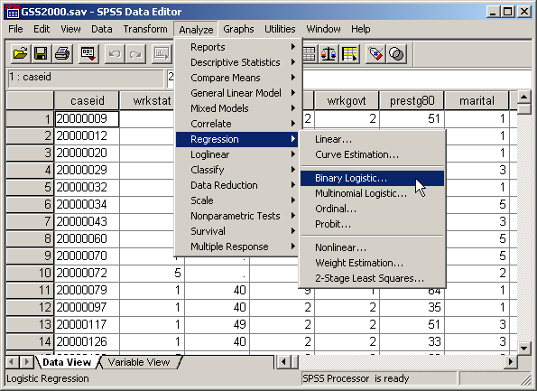
Request simultaneous logistic regression
Select the Regression | Binary Logistic… command from the Analyze menu.

Slide 16
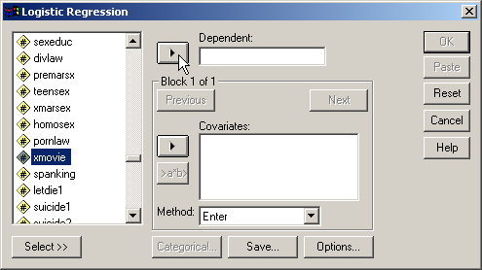
Selecting the dependent variable
First, highlight the dependent variable xmovie in the list of variables.
Second, click on the right arrow button to move the dependent variable to the Dependent text box.

Slide 17
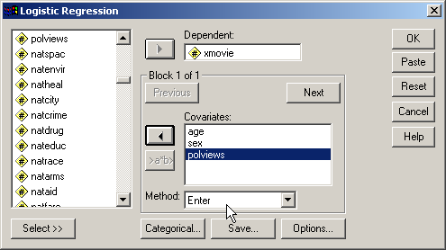
Selecting the independent variables
Move the independent variables listed in the problem to the Covariates list box.

Slide 18
Specifying the method for including variables
SPSS provides us with two methods for including variables: to enter all of the independent variables at one time, and a stepwise method for selecting variables using a statistical test to determine the order in which variables are included.
SPSS also supports the specification of "Blocks" of variables for testing hierarchical models.
Since the problem states that there is a relationship without requesting the best predictors, we specify Enter as the method for including variables.

Slide 19
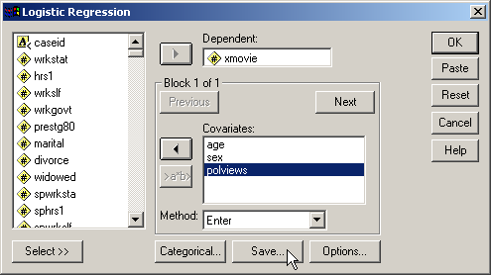
Requesting statistics needed for identifying outliers and influential cases
SPSS will calculate the values for standardized residuals and Cook's distance, and save them to the data set.
Click on the Save… button to request the statistics what we want to save.

Slide 20
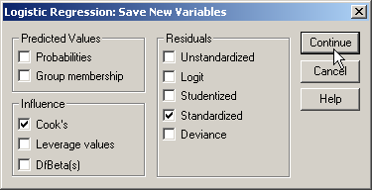
Saving statistics needed for identifying outliers and influential cases
First, mark the checkbox for Standardized residuals in the Residuals panel.
Third, click on the Continue button to complete the specifications.
Second, mark the checkbox for Cook’s in the Influence panel. This will compute Cook’s distances to identify influential cases.

Slide 21
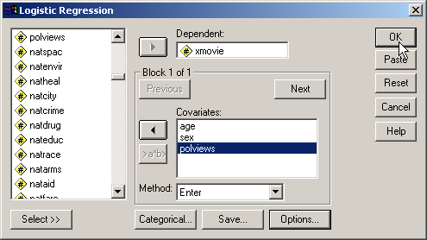
Completing the logistic regression request
Click on the OK button to request the output for the logistic regression.
The logistic procedure supports the selection of subsets of cases, automatic recoding of nominal variables, saving diagnostic statistics like standardized residuals and Cook's distance, and options for additional statistics. However, none of these are needed for this analysis.

Slide 22
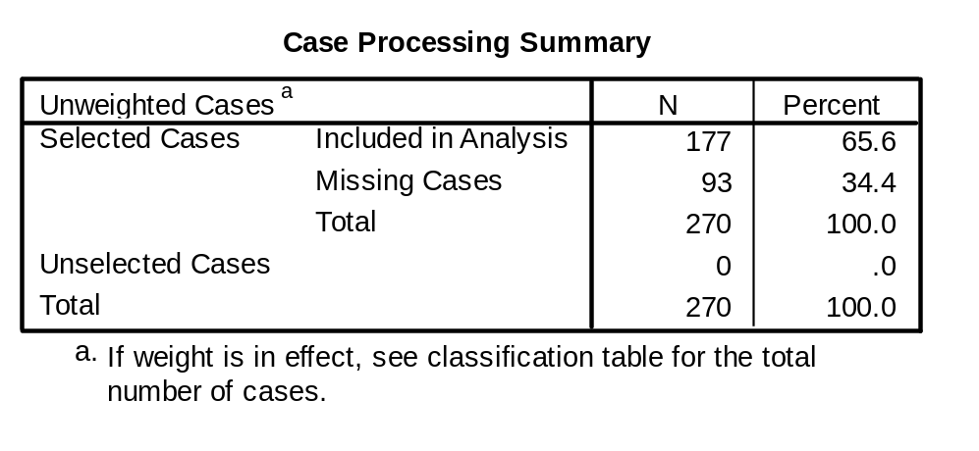
Number of cases including outliers and influential cases
There are 177 cases included cases, including those that might later be identified as outliers or influential cases.

Slide 23
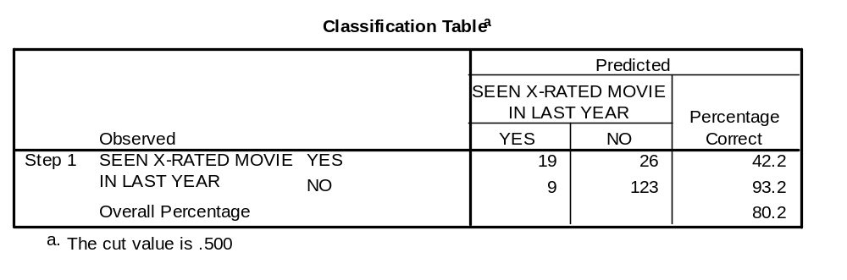
Classification accuracy for all cases
With all cases, including those that might be identified as outliers or influential cases, the accuracy rate was 80.2%.

Slide 24
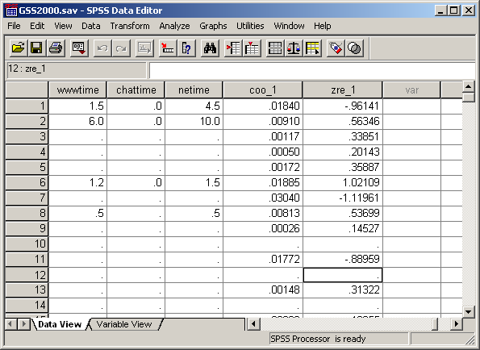
The variables for identifying outliers and influential cases
The variable for identifying outliers for the logistic regression are in a column which SPSS has named zre_1. These are the standardized residuals for dependent variable.
The variable containing Cook’s distances for identifying influential cases has been named coo_1 by SPSS.

Slide 25
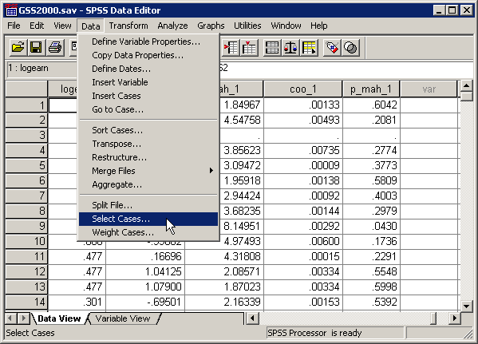
Omitting the outliers and influential cases
To omit the outliers and influential cases from the analysis, we select in the cases that are not outliers and are not influential cases.
First, select the Select Cases… command from the Transform menu.

Slide 26
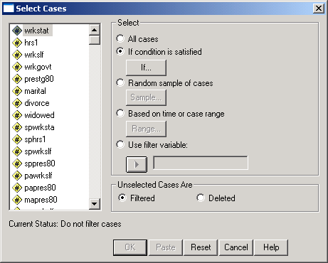
Specifying the condition to omit outliers
First, mark the If condition is satisfied option button to indicate that we will enter a specific condition for including cases.
Second, click on the If… button to specify the criteria for inclusion in the analysis.

Slide 27
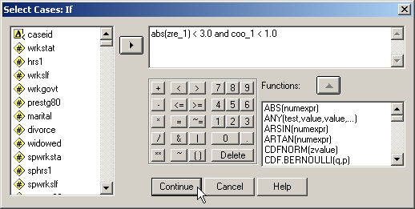
The formula for omitting outliers
To eliminate the outliers and influential cases, we request the cases that are not outliers or influential cases.
The formula specifies that we should include cases if the standardized residual (regardless of sign) is less than 3 and the Cook’s distance value is less than 1.0.
After typing in the formula, click on the Continue button to close the dialog box,

Slide 28
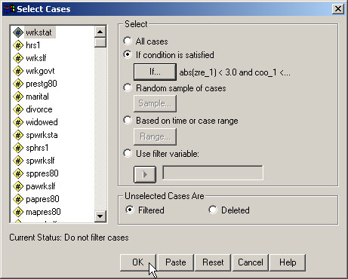
Completing the request for the selection
To complete the request, we click on the OK button.

Slide 29
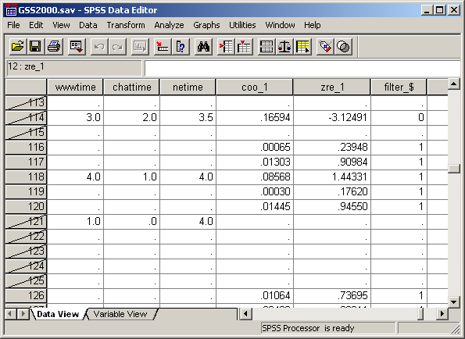
An omitted outlier and influential case
While SPSS identifies the excluded cases by drawing a slash mark through the case number.
This omitted case has a large standardized residual greater than 3.0.
While most of the omitted cases were due to missing data, there were three cases with large standardized residuals: case 20001088, standardized residual=-3.12; case 20001804, standardized residual=-3.94; and case 20002479 standardized residual=-3.10.

Slide 30
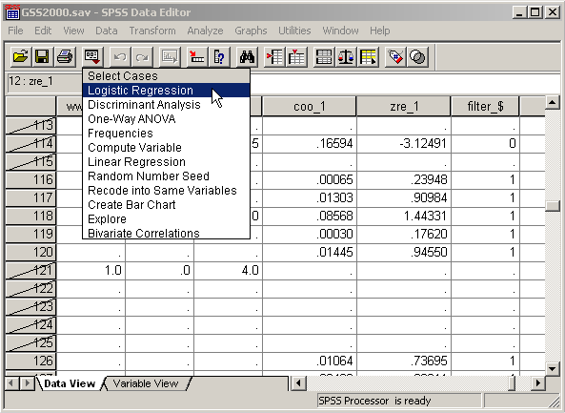
Running the logistic regression omitting outliers
We run the regression again, without the outliers which we selected out with the Select If command.
Click on the Dialog Recall tool button and select Logistic Regression from the drop-down menu.

Slide 31
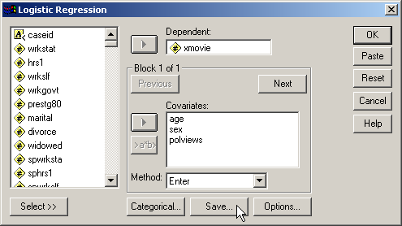
Opening the save options dialog
We will keep all of the specifications from the previous analysis except for the request to save standardized residuals and Cook's distance.
On our last run, we instructed SPSS to save standardized residuals, and Cook’s distance. To prevent these values from being calculated again, click on the Save… button.

Slide 32
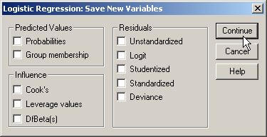
Clearing the request to save diagnostic data
First, clear the checkbox for Standardized residuals.
Third, click on the Continue button to complete the specifications.
Second, clear the checkbox form Cook’s distance.

Slide 33
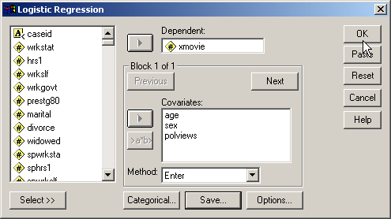
Requesting the output
Having specified the output needed for the analysis, we click on the OK button to obtain the logistic regression output.

Slide 34

Classification accuracy after omitting outliers
After omitting three outliers, the classification accuracy rate is 81.0%.

Slide 35
SELECTION OF MODEL FOR INTERPRETATION
Prior to the removal of outliers and influential cases, the accuracy rate of the logistic regression model was 80.2%. After removing outliers and influential cases, the accuracy rate of the logistic regression model was 81.0%.
Since the logistic regression omitting outliers and influential cases was less than two percent more accurate in classifying cases than the logistic regression with all cases, the logistic regression model with all cases was interpreted.

Slide 36
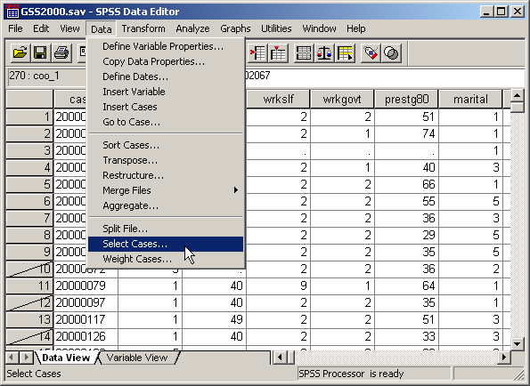
Restoring all cases to the data set
To run the model with all cases in it, we must first restore all of the cases to the data set.
Click on the Select Cases… command in the Data menu.

Slide 37
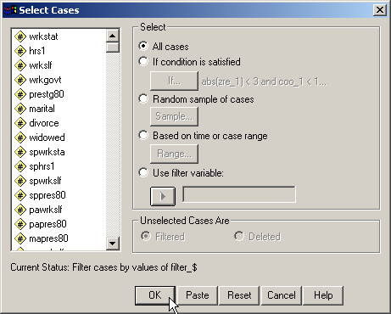
Selecting all cases
First, click on the All cases option button to undo the select if command issued to remove outliers.
Second, click on the OK button to complete the command.

Slide 38
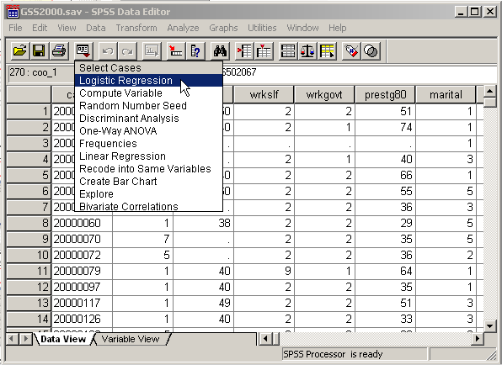
Running the logistic regression again with all cases included
We run the regression again after restoring all cases to the data set, included those that we could designate as outliers.
Click on the Dialog Recall tool button and select the Logistic Regression command from the drop down menu.

Slide 39

Completing the request for logistic regression
All of the specifications for the analysis have been entered in previous analyses, so we do not need to make any changes.
To run the regression again after restoring all cases to the data set, click on the OK button.

Slide 40
Sample size – ratio of cases to variables
The minimum ratio of valid cases to independent variables for logistic regression is 10 to 1, with a preferred ratio of 20 to 1. In this analysis, there are 177 valid cases and 3 independent variables. The ratio of cases to independent variables is 59.0 to 1, which satisfies the minimum requirement. In addition, the ratio of 59.0 to 1 satisfies the preferred ratio of 20 to 1.

Slide 41
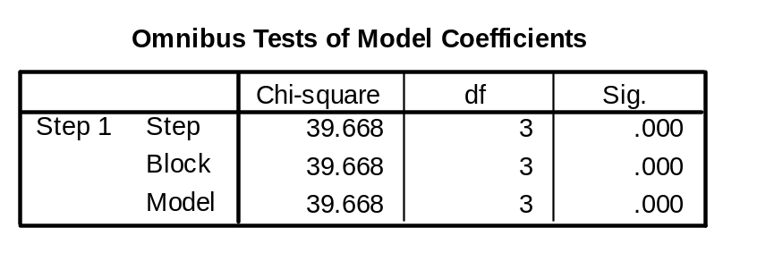
OVERALL RELATIONSHIP BETWEEN INDEPENDENT AND DEPENDENT VARIABLES
The presence of a relationship between the dependent variable and combination of independent variables is based on the statistical significance of the model chi-square at step 1 after the independent variables have been added to the analysis.
In this analysis, the probability of the model chi-square (39.668) was <0.001, less than or equal to the level of significance of 0.05. The null hypothesis that there is no difference between the model with only a constant and the model with independent variables was rejected. The existence of a relationship between the independent variables and the dependent variable was supported.

Slide 42
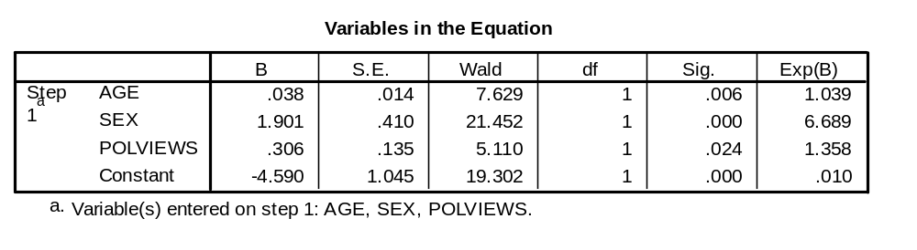
NUMERICAL PROBLEMS
Multicollinearity in the logistic regression solution is detected by examining the standard errors for the b coefficients. A standard error larger than 2.0 indicates numerical problems, such as multicollinearity among the independent variables, zero cells for a dummy-coded independent variable because all of the subjects have the same value for the variable, and 'complete separation' whereby the two groups in the dependent event variable can be perfectly separated by scores on one of the independent variables. Analyses that indicate numerical problems should not be interpreted.
None of the independent variables in this analysis had a standard error larger than 2.0. (The check for standard errors larger than 2.0 does not include the standard error for the Constant.)

Slide 43
RELATIONSHIP OF INDIVIDUAL INDEPENDENT VARIABLES TO DEPENDENT VARIABLE - 1
The probability of the Wald statistic for the variable age was 0.006, less than or equal to the level of significance of 0.05. The null hypothesis that the b coefficient for age was equal to zero was rejected. This supports the relationship that "survey respondents who were older were more likely to have not seen an x-rated movie."
The value of Exp(B) was 1.039 which implies that a one unit increase in age increased the odds that survey respondents have not seen an x-rated movie by 3.9%. This confirms the statement of the amount of change in the likelihood of belonging to the modeled group of the dependent variable associated with a one unit change in the independent variable, age.

Slide 44
RELATIONSHIP OF INDIVIDUAL INDEPENDENT VARIABLES TO DEPENDENT VARIABLE - 2
The probability of the Wald statistic for the variable sex was <0.001, less than or equal to the level of significance of 0.05. The null hypothesis that the b coefficient for sex was equal to zero was rejected. This supports the relationship that "survey respondents who were female were approximately six and three quarters times more likely to have not seen an x-rated movie."
The value of Exp(B) was 6.689 which implies that a one unit increase in sex increased the odds by approximately six and three quarters times that survey respondents have not seen an x-rated movie.

Slide 45
RELATIONSHIP OF INDIVIDUAL INDEPENDENT VARIABLES TO DEPENDENT VARIABLE - 3
The probability of the Wald statistic for the variable liberal or conservative political views was 0.024, less than or equal to the level of significance of 0.05. The null hypothesis that the b coefficient for liberal or conservative political views was equal to zero was rejected. This supports the relationship that "survey respondents who were more conservative were more likely to have not seen an x-rated movie." Liberal or conservative political views is an ordinal variable that is coded so that higher numeric values are associated with survey respondents who were more conservative.
The value of Exp(B) was 1.358 which implies that a one unit increase in liberal or conservative political views increased the odds that survey respondents have not seen an x-rated movie by approximately one and a quarter times.

Slide 46
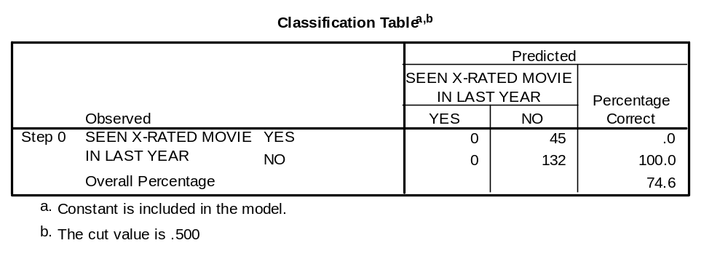
CLASSIFICATION USING THE LOGISTIC REGRESSION MODEL: by chance accuracy rate
The independent variables could be characterized as useful predictors distinguishing survey respondents who have not seen an x-rated movie from survey respondents who have seen an x-rated movie if the classification accuracy rate was substantially higher than the accuracy attainable by chance alone. Operationally, the classification accuracy rate should be 25% or more higher than the proportional by chance accuracy rate.
The proportional by chance accuracy rate was computed by first calculating the proportion of cases for each group based on the number of cases in each group in the classification table at Step 0. The proportion in the "YES" group is 45/177 = 0.254. The proportion in the "No" group is 132/177 = 0.746.
Then, we square and sum the proportion of cases in each group (0.254² + 0.746² = 0.621). 0.621 is the proportional by chance accuracy rate.

Slide 47
CLASSIFICATION USING THE LOGISTIC REGRESSION MODEL: criteria for classification accuracy
The accuracy rate computed by SPSS was 80.2% which was greater than or equal to the proportional by chance accuracy criteria of 77.6% (1.25 x 62.1% = 77.6%).
The criteria for classification accuracy is satisfied.

Slide 48
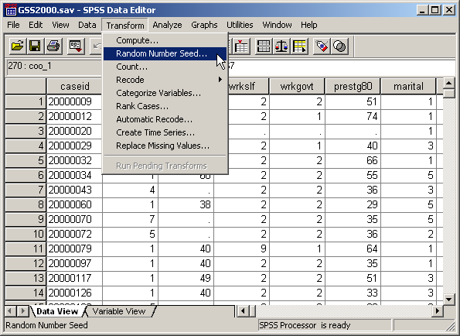
Validation analysis: set the random number seed
To set the random number seed, select the Random Number Seed… command from the Transform menu.

Slide 49
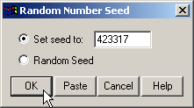
Set the random number seed
First, click on the Set seed to option button to activate the text box.
Second, type in the random seed stated in the problem.
Third, click on the OK button to complete the dialog box.
Note that SPSS does not provide you with any feedback about the change.

Slide 50
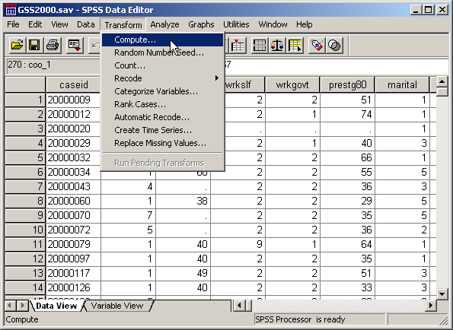
Validation analysis: compute the split variable
To enter the formula for the variable that will split the sample in two parts, click on the Compute… command.

Slide 51
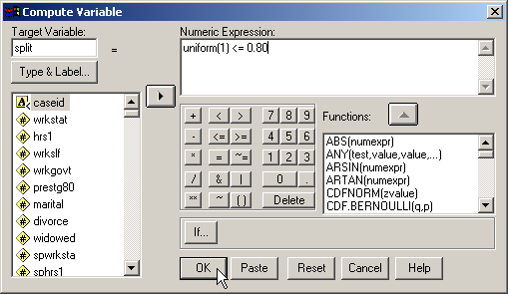
The formula for the split variable
First, type the name for the new variable, split, into the Target Variable text box.
Second, the formula for the value of split is shown in the text box.
The uniform(1) function generates a random decimal number between 0 and 1. The random number is compared to the value 0.80.
If the random number is less than or equal to 0.80, the value of the formula will be 1, the SPSS numeric equivalent to true. If the random number is larger than 0.80, the formula will return a 0, the SPSS numeric equivalent to false.
Third, click on the OK button to complete the dialog box.

Slide 52
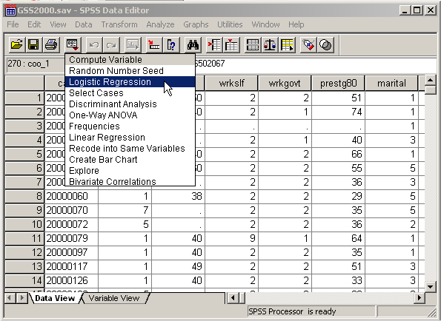
Repeat the regression with validation sample
To repeat the logistic regression analysis for the first validation sample, select Logistic Regression from the Dialog Recall tool button.

Slide 53
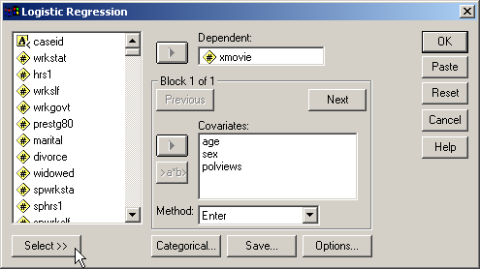
Activating the command for subsets of cases
First, click on the Select button to open the panel for selecting a subset of cases.

Slide 54
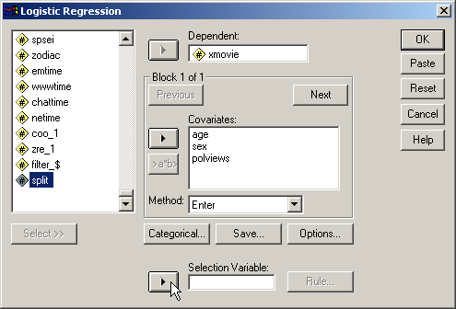
Using "split" as the selection variable
First, scroll down the list of variables and highlight the variable split.
Second, click on the right arrow button to move the split variable to the Selection Variable text box.

Slide 55
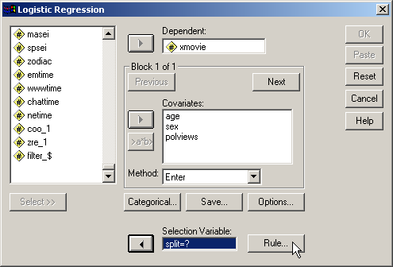
Setting the value of split to select cases
When the variable named split is moved to the Selection Variable text box, SPSS adds "=?" after the name to prompt up to enter a specific value for split.
Click on the Rule… button to enter a value for split.

Slide 56
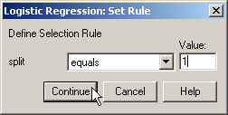
Completing the value selection
First, type the value for the first half of the sample, 1, into the Value text box.
Second, click on the Continue button to complete the value entry.

Slide 57

Requesting output for the validation sample
Click on the OK button to request the output.
When the value entry dialog box is closed, SPSS adds the value we entered after the equal sign. This specification now tells SPSS to include in the analysis only those cases that have a value of 1 for the split variable.

Slide 58

SPLIT-SAMPLE VALIDATION - 1
In the cross-validation analysis, the relationship between the independent variables and the dependent variable was statistically significant.
The probability for the model chi-square (33.498) testing overall relationship was <0.001.
The significance of the overall relationship between the individual independent variables and the dependent variable supports the interpretation of the model using the full data set.

Slide 59

SPLIT-SAMPLE VALIDATION - 2
The relationship between "age" [age] and "seen x-rated movie in last year" [xmovie] was statistically significant for the model using the full data set (p=0.006). Similarly, the relationship in the cross-validation analysis was statistically significant.
In the cross-validation analysis, the probability for the test of relationship between "age" [age] and "seen x-rated movie in last year" [xmovie] was 0.013, which was less than or equal to the level of significance of 0.05 and statistically significant.

Slide 60
SPLIT-SAMPLE VALIDATION - 3
The relationship between "sex" [sex] and "seen x-rated movie in last year" [xmovie] was statistically significant for the model using the full data set (p<0.001). Similarly, the relationship in the cross-validation analysis was statistically significant.
In the cross-validation analysis, the probability for the test of relationship between "sex" [sex] and "seen x-rated movie in last year" [xmovie] was <0.001, which was less than or equal to the level of significance of 0.05 and statistically significant.

Slide 61
SPLIT-SAMPLE VALIDATION - 4
The relationship between "liberal or conservative political views" [polviews] and "seen x-rated movie in last year" [xmovie] was statistically significant for the model using the full data set (p=0.024). Similarly, the relationship in the cross-validation analysis was statistically significant.
In the cross-validation analysis, the probability for the test of relationship between "liberal or conservative political views" [polviews] and "seen x-rated movie in last year" [xmovie] was 0.027, which was less than or equal to the level of significance of 0.05 and statistically significant.
The pattern of significance of the relationships between the individual independent variables and the dependent variable supports the interpretation of the model using the full data set.

Slide 62
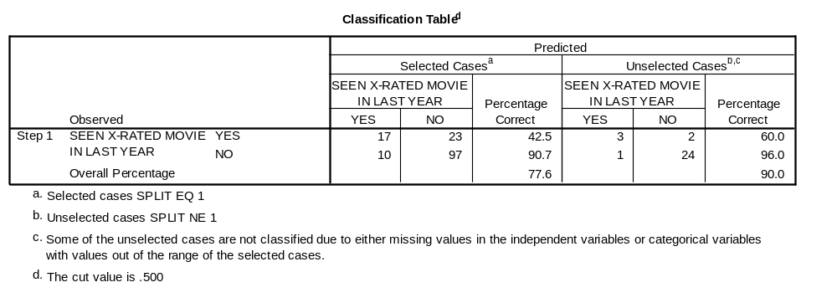
SPLIT-SAMPLE VALIDATION - 5
The criteria to support the classification accuracy of the model is an accuracy rate for the holdout sample that is no more than 10% lower than the accuracy rate for the training sample.
The accuracy rate for the training sample was 77.6%, making the minimum requirement for the holdout sample equal to 69.8% (0.90 x 77.6%).
The accuracy rate for the holdout sample was 90.0%, which satisfied the minimum requirement.
The classification accuracy for the analysis of the full data set was supported.

Slide 63
Answering the question in problem 1 - 1
In the dataset GSS2000.sav, is the following statement true, false, or an incorrect application of a statistic? Assume that there is no problem with missing data. Use a level of significance of 0.05 for evaluating the statistical relationship. Test the generalizability of the logistic regression model with a cross-validation analysis using a 80% random sample of the data set as a training sample. Use 423317 as the random number seed.
The variables "age" [age], "sex" [sex], and "liberal or conservative political views" [polviews] were useful predictors for distinguishing between groups based on responses to "seen x-rated movie in last year" [xmovie]. These predictors differentiate survey respondents who have not seen an x-rated movie from survey respondents who have seen an x-rated movie.
Survey respondents who were older were more likely to have not seen an x-rated movie. A one unit increase in age increased the odds that survey respondents have not seen an x-rated movie by 3.9%. Survey respondents who were female were approximately six and three quarters times more likely to have not seen an x-rated movie. Survey respondents who were more conservative were more likely to have not seen an x-rated movie. A one unit increase in liberal or conservative political views increased the odds that survey respondents have not seen an x-rated movie by approximately one and a quarter times.
1. True
2. True with caution
3. False
4. Inappropriate application of a statistic
We found a statistically significant overall relationship between the combination of independent variables and the dependent variable.
There was no evidence of numerical problems in the solution.
Moreover, the classification accuracy surpassed the proportional by chance accuracy criteria, supporting the utility of the model.

Slide 64
Answering the question in problem 1 - 2
We verified that each statement about the relationship between an independent variable and the dependent variable was correct in both direction of the relationship and the change in likelihood associated with a one-unit change of the independent variable.
In the dataset GSS2000.sav, is the following statement true, false, or an incorrect application of a statistic? Assume that there is no problem with missing data. Use a level of significance of 0.05 for evaluating the statistical relationship. Test the generalizability of the logistic regression model with a cross-validation analysis using a 80% random sample of the data set as a training sample. Use 423317 as the random number seed.
The variables "age" [age], "sex" [sex], and "liberal or conservative political views" [polviews] were useful predictors for distinguishing between groups based on responses to "seen x-rated movie in last year" [xmovie]. These predictors differentiate survey respondents who have not seen an x-rated movie from survey respondents who have seen an x-rated movie.
Survey respondents who were older were more likely to have not seen an x-rated movie. A one unit increase in age increased the odds that survey respondents have not seen an x-rated movie by 3.9%. Survey respondents who were female were approximately six and three quarters times more likely to have not seen an x-rated movie. Survey respondents who were more conservative were more likely to have not seen an x-rated movie. A one unit increase in liberal or conservative political views increased the odds that survey respondents have not seen an x-rated movie by approximately one and a quarter times.
1. True
2. True with caution
3. False
4. Inappropriate application of a statistic
The 80-20 split-sample validation supported the interpretation of overall relationship, individual relationships, and classification accuracy of the model.
The answer to the question is true with caution.
A caution is added because of the inclusion of ordinal level variables.

Slide 65
Steps in binary logistic regression: level of measurement and initial sample size
The following is a guide to the decision process for answering
problems about the basic relationships in logistic regression:
Dependent dichotomous?
Independent variables metric or dichotomous?
No
Inappropriate application of a statistic
Yes
Ratio of cases to independent variables at least 10 to 1?
No
Inappropriate application of a statistic
Yes
Yes

Slide 66
Steps in binary logistic regression: level of measurement and initial sample size
Yes
Run baseline logistic regression, using method for including variables identified in the research question.
Record classification accuracy for evaluation of the effect of removing outliers and influential cases.
Outliers/influential cases by standardized residuals or Cook's distance?
Yes
Remove outliers and influential cases from data set
No
Ratio of cases to independent variables at least 10 to 1?
No
Restore outliers and influential cases to data set, add caution to findings
Yes

Slide 67
Steps in binary logistic regression: picking model for interpretation
Were outliers and influential cases omitted from the analysis?
No
Yes
Evaluate impact of removal of outliers by running logistic regression again, using method for including variables identified in the research question.
Classification accuracy omitting outliers better than baseline by 2% or more?
Yes
No
Pick logistic regression that omits outliers for interpretation
Pick baseline logistic regression
for interpretation

Slide 68
Steps in logistic regression: overall relationship and numerical problems
Hierarchical method of entry used to include independent variables?
No
Yes
Presence of relationship confirmed by test of model chi-square?
Presence of relationship confirmed by test of block chi-square?
No
No
False
Yes
Yes
False
Standard errors of coefficients indicate presence of numerical problems (s.e. > 2.0)?
Yes
False
No

Slide 69
Steps in logistic regression: relationships between IV's and DV
Stepwise method of entry used to include independent variables?
Yes
No
Entry order of variables interpreted correctly?
No
Yes
False
Relationships between individual IVs and DV groups interpreted correctly?
No
False
Yes

Slide 70
Steps in logistic regression: classification accuracy and validation
Overall accuracy rate is 25% > than proportional by chance accuracy rate?
No
False
Yes
Yes
Compute 80-20 split variable.
Re-run baseline logistic regression, using method for including variables identified in the research question.
Overall relationship in teaching sample supports full model?
No
False
Yes

Slide 71
Steps in logistic regression: validation supports generalizability
If hierarchical model, block chi-square for predictors <= level of significance?
No
False
Yes
Significance of predictors in teaching sample matches pattern for model using full data set?
No
False
Yes
Classification accuracy for holdout sample close enough to training sample?
No
False
Yes

Slide 72
Steps in logistic regression: adding cautions
Satisfies preferred ratio of cases to IV's of 20 to 1
(50 to 1 for stepwise)
No
True with caution
Yes
Yes
One or more IV's are ordinal level variables?
Yes
True with caution
No
True

